Slide 1
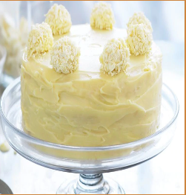
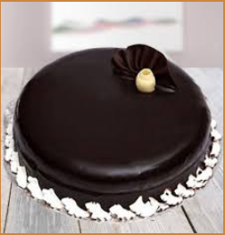
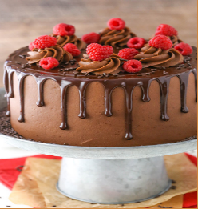
Review
Account
Order
Special
Home
CHOC O LAT
Cakes

Slide 2
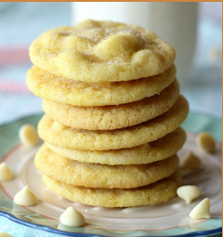
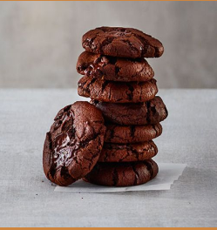
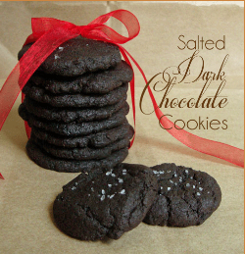
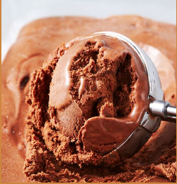
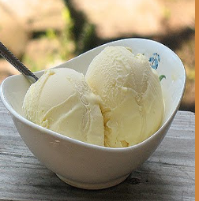
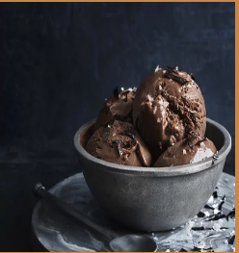
Biscuits
Ice cream

Slide 3



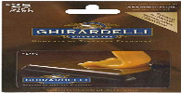


All the customer that have an account with us from more than 3 months can use the weekly discount
This offer is quite limited for those that have more have spent more than 200£ on our website.
This special offer comes up every month for those have particulary taken almost all the product.
Discount Offer
The gift card red represent our costumer that have choose this card as credit and get points.
The brown gift card it let you take more than 3 items free and pay 2 extra item free.
The blue card it let you have an enlarge discount for students and youngster.

Slide 4



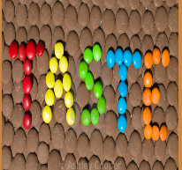


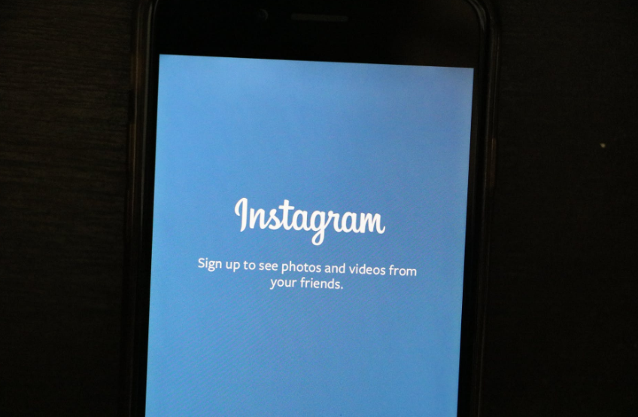


Email: cholatetaste@gmail.com
Address:Ashton Underlyne M11 27W
Telephone: 07451864828

